Slide 1
PREDICTING Movie AUDIENCE SCORE
Brandon Parmanand

Slide 2
Data
651 Movies Released between 1970 and 2014
Movie Title
Title Type
Genre
Runtime
MPAA Rating
Studio
Theater Release Dates
DVD Release Dates
IMBD Rating and # of Votes
Rotten Tomatoes Critics Scores/Ratings
Rotten Tomatoes Audience Scores/Ratings
Award Nomination/Wins
Director
Actors
Notes:
My data set consists of 651 movies released in theaters and on DVD between the period of 1970 and 2014 with 33 variables.
We have the title, title type which is categorized as Feature Film, TV movie, or documentary
Genre, movie runtime, the rating of the movie and release dates whether in in theater or dvd
It also includes IMDB Ratings and Rotten tomatoes critics and audience ratings
Includes the top 5 actors, the director,
Includes award nomination and wins from the Oscars such as best actor, actress, director

Slide 3
Target problem
Looking into the correlations between many of the variables such as critic score and audience score, genre and the audience score, or MPAA rating and audience score.
What variables affect the audience score and can we predict the audience score using the variables such as genre, critic rating, IMBD rating, release date, and runtime?
Notes:
For my target problem I wanted to look into what correlations existed between the variables and the audience score. Does a specific rating have a correlation with how the audience rates it and
Can we predict what the audience score is using genre, critic rating, IMBD rating, release date, and runtime?.

Slide 4
Proposed statistical analysis
Explore the data using data visualization, dimension reduction, and other data exploration methods
Use a neural network to make predictions about the data
Use a linear regression model to predict the audience score
Notes:
Explore the data using data visualization, dimension reduction, and other data exploration methods
Use a neural network to make predictions about the data
Use a linear regression model to predict the audience score

Slide 5
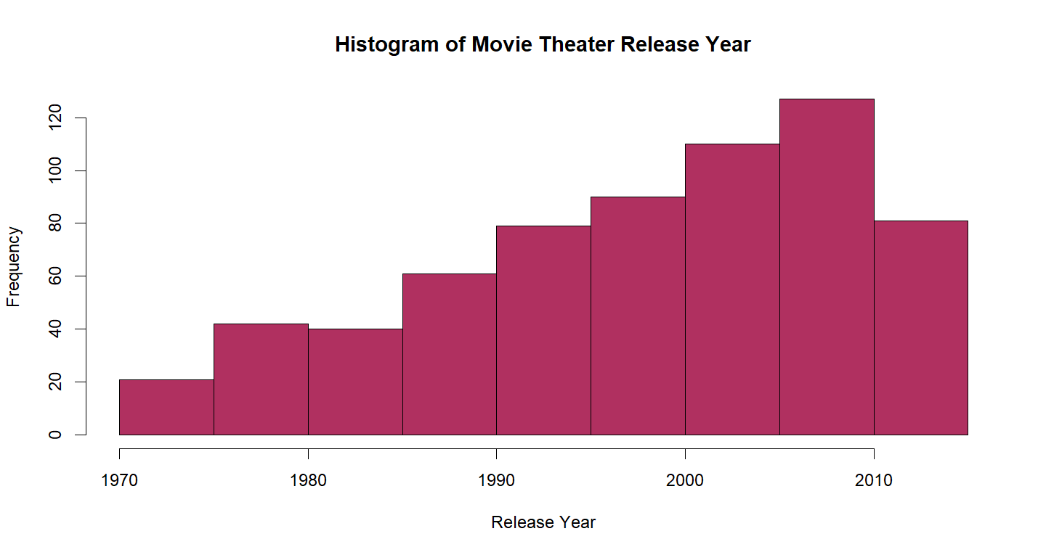
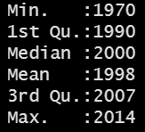
Notes:
We have a range of 44 years between 1970 and 2014 and we see the movies in this data set have been growing over the years

Slide 6
Does release season have effect on Scores/Ratings?
Summer Release Season
June and July – Movies released during this season are expected to bring in the most box office revenue and have the most turnout of viewers in theaters
Award Release Season
November and December – Movies released during this season are expected to be nominated for awards
Notes:
Movies are generally heavily released in two seasons. The Summer Season in June and July which are released to bring the most profit to the box office. Students are out of school and watch a lot more movies
Award release season is November and December release dates to prepare for the award show season such as the Oscars

Slide 7
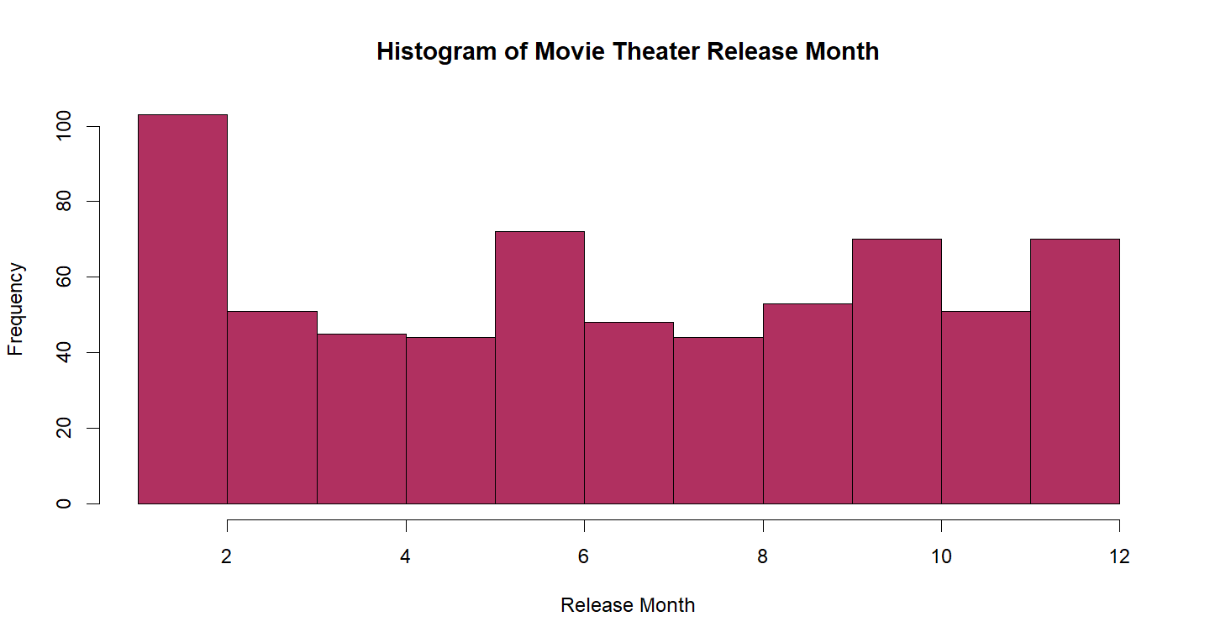
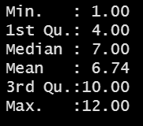
Notes:
I plotted this histogram to see if the release dates of the movies in the data set followed this trend. We can see some upticks but nothing major.

Slide 8
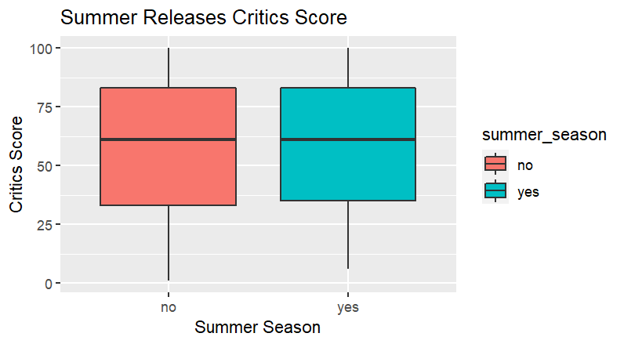
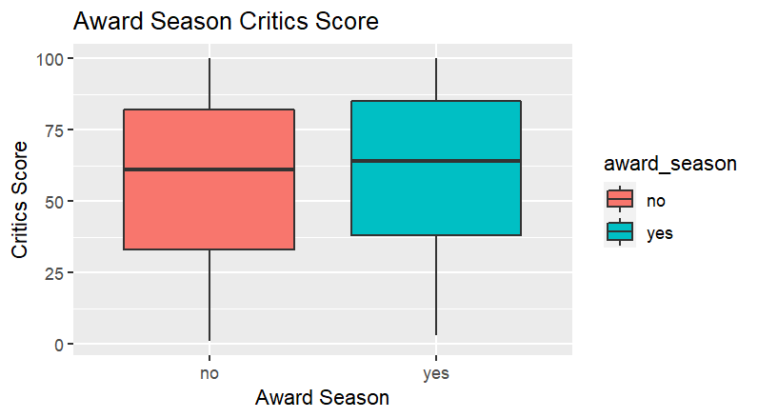
Does release season have effect on Critics Score?
Notes:
Both the summer season and award season does not have a strong correlation to critics scores

Slide 9
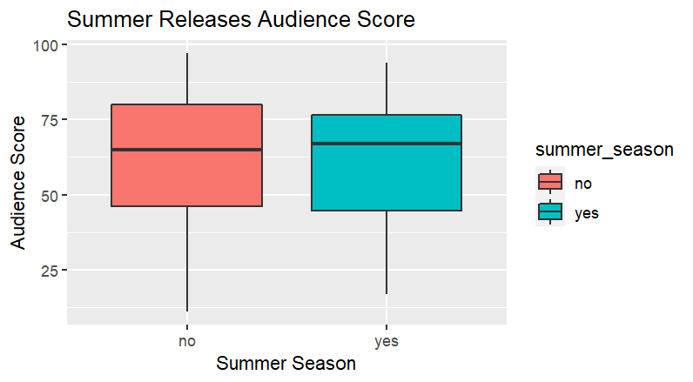
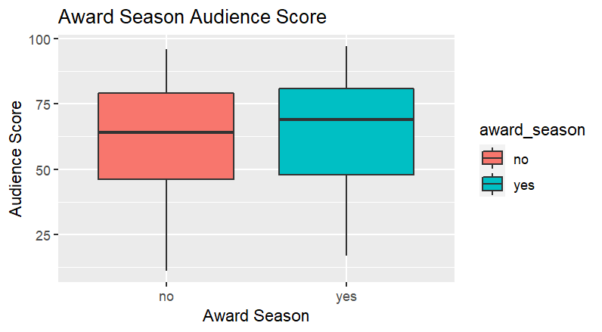
Does release season have effect on Audience Score?
Notes:
the summer season and award season does not have a strong correlation to audience scores

Slide 10
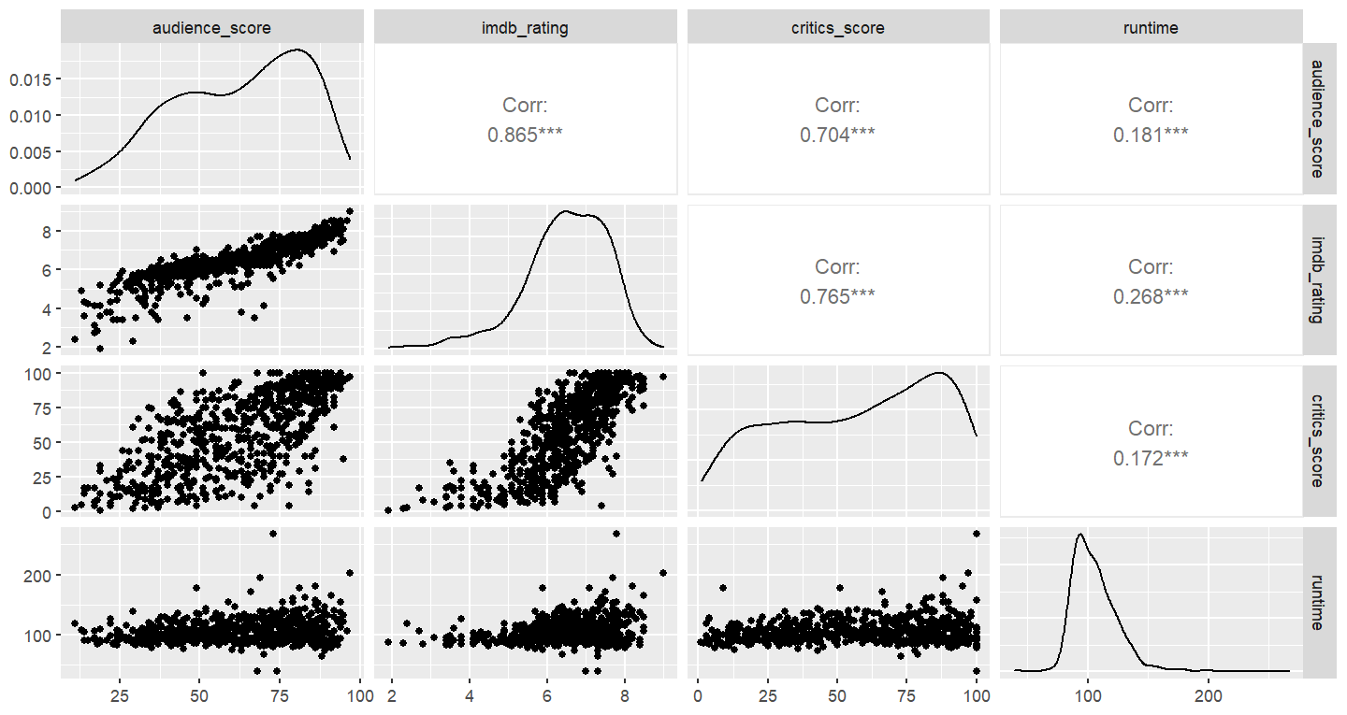
Notes:
Scatter plot matrix – shows there is a strong correlation between IMDB Rating and audience score, IMDB Rating and critics score, and audience score and critics score. Runtime is not as strongly correlated

Slide 11
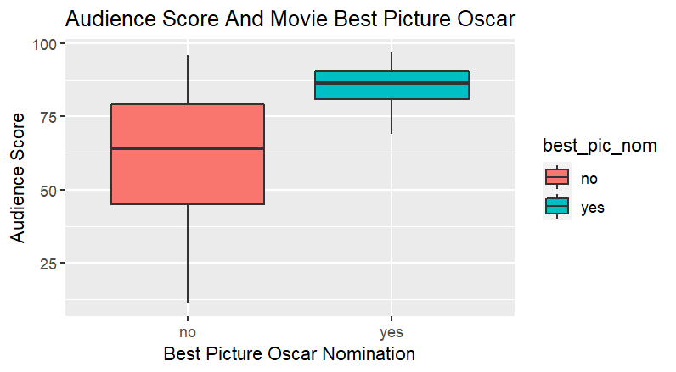
Notes:
Best Pic nomination tends to have a higher cirtic score

Slide 12
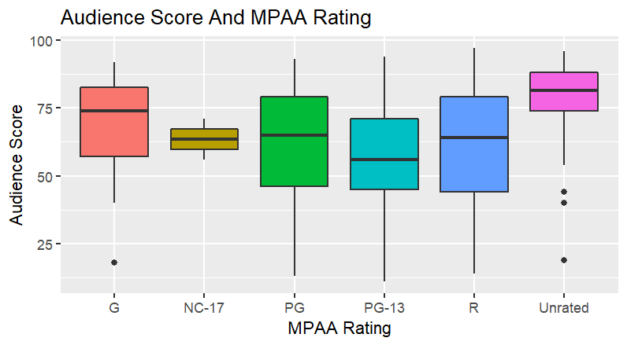

Slide 13
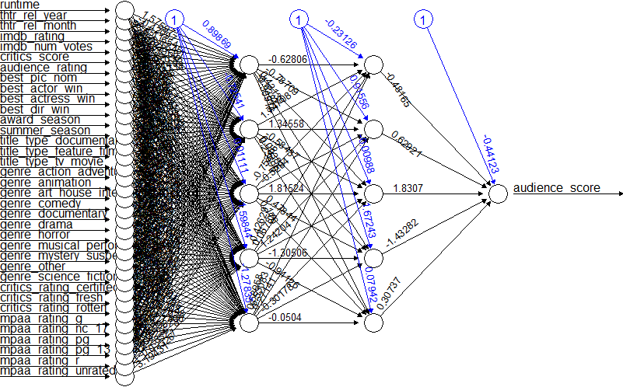
Neural Network training data
Notes:
Converted yes no data to binary
Created dummy variables for movie type, genre, critic ratings, and the mpaa ratings
This resulted in having 36 predictor variables
Converted all data to numeric and then normalized using the preprocess function to scale the data between the range of 0 and 1 Split data into training and validation.
Hidden nodes = 5

Slide 14
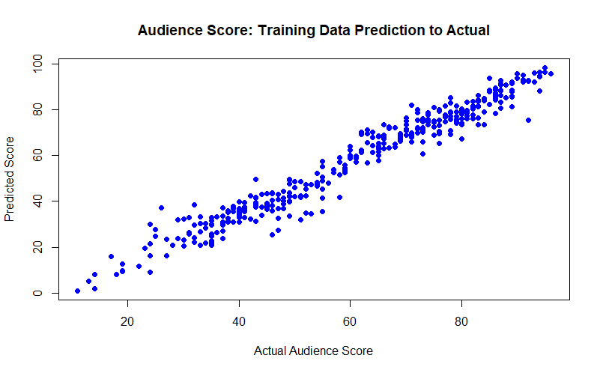

Slide 15

Neural Network Valid data

Slide 16
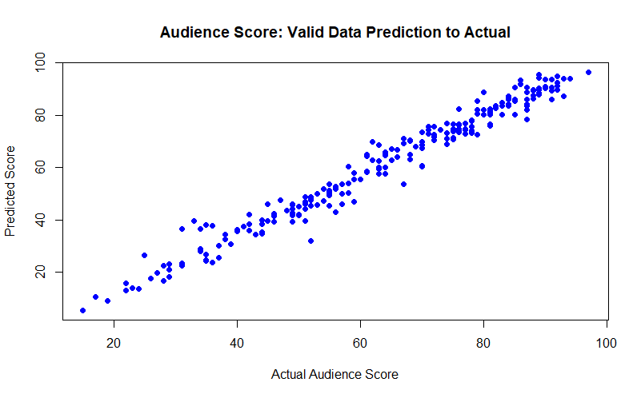

Slide 17
RMSPE
Root Mean Square Percentage Error Loss
0.13

Slide 18
Linear Regression Model
Forward selection
Backward elimination
Stepwise regression

Slide 19
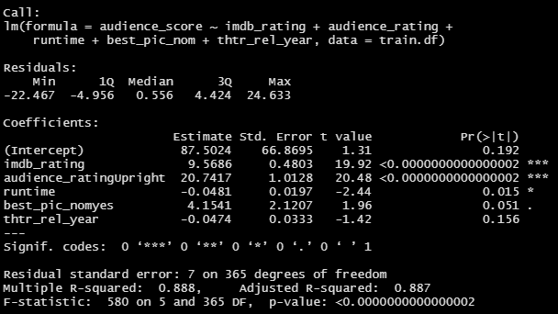

Slide 20
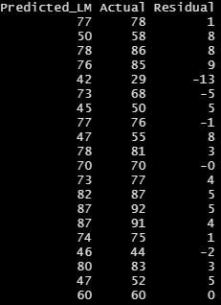
Predicted vs Actual Scores

Slide 21
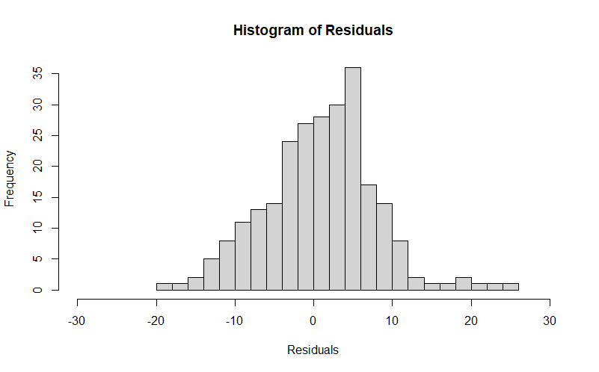


Slide 22
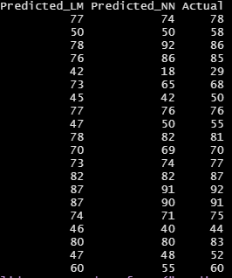
Comparing Actual score to predictions
Notes:
Here I am taking a look at the Predicted audience score from the linear model, predicted audience score from the NN and the actual score.
Some you can see that the neural network model can perform better in predicting but overall the linear regression was the best

Slide 23
Conclusion
I conclude that we can predict the audience score using other predictor variables.
Neural Network can produce a powerful prediction of audience score.
Linear regression model with fewer variables than the were able to produce a better prediction of audience score.
Notes:
Explore the data using data visualization, dimension reduction, and other data exploration methods
Use a neural network to make predictions about the data
Use a linear regression model to predict the audience score
More time -

Slide 24
Next steps
Even though linear model algorithms were chosen, I’d like to run manual ANOVA tests against all the potential models as the small datasets can have plenty of variance
Would like to explore neural networks for this
Base this model around a similar but larger dataset

